Slide 1

By Marco Esposito @ Codeworks

Slide 2
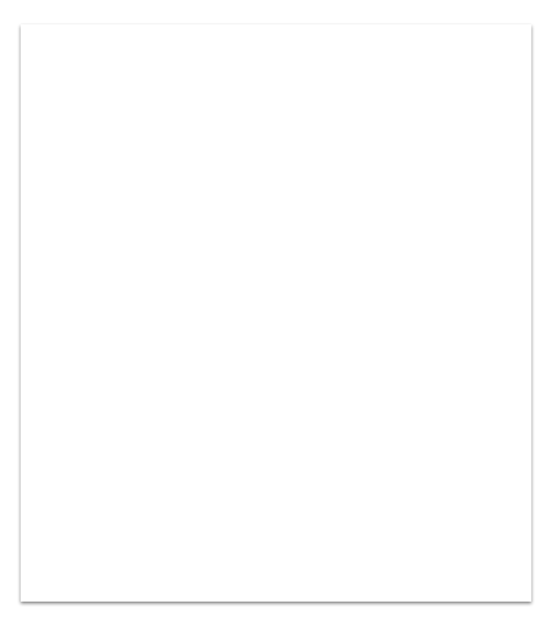
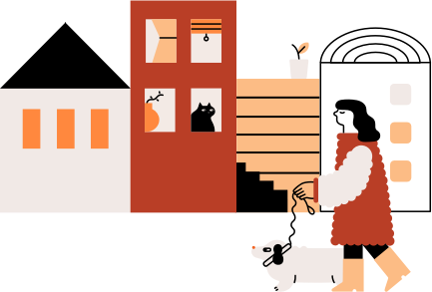
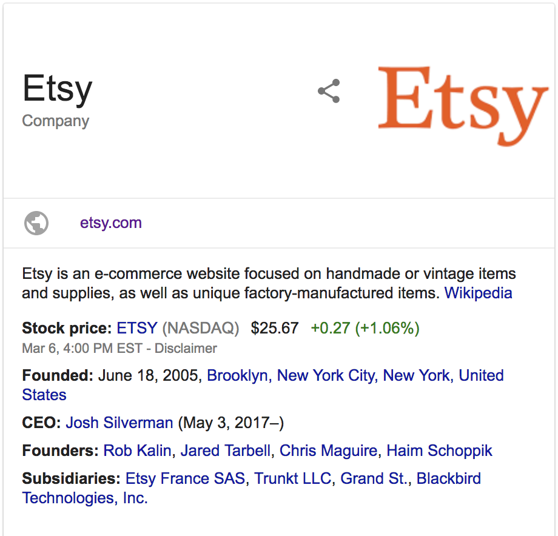
More than 18 million of handmade items quoted on the stock exchange
Sellers are mostly women with a home studio.
They often run more than one shop, little time to do it!

Slide 3

Starting as business in one click
Publishing items in one click
Social sharing in one click
Shipping in one click
…..more and more features in one click!

Slide 4
D E M O

Slide 5






Technologies
FRONT-END:
React
Redux
Material-UI + CSSTransitionGroup
BACK-END:
Node.js + KOA
Passport
Facebook and Twitter API’s

Slide 6

Next steps
Pinterest and Instagram sharing
Fix some minor bugs
Better error handling
Add other features in one click
Deploying

Slide 7

I learnt...
Designing the flow
OAuth authentication protocol
Dealing with NPM packages
Time management

Slide 8
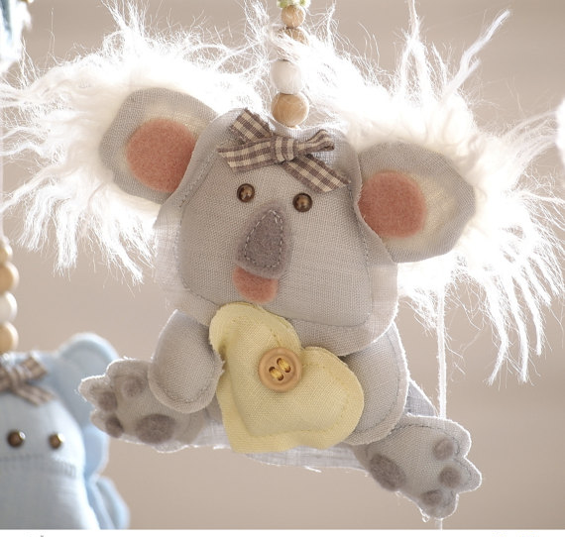
T H A N K S !

